Slide 1
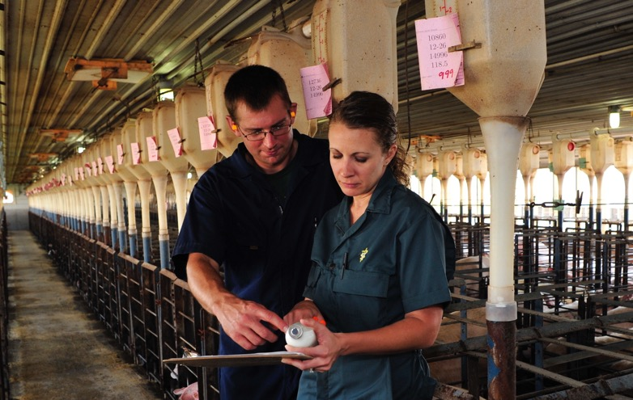
Veterinarians
Key Drivers in Food Safety
Notes:
My name is __________________________________. I‘m a swine veterinarian. My background is _______________________.
I’m here today to lead a discussion about how veterinary medicine is both vital to advancements in animal health and a driving force in food safety – a key concern of consumers today.
And I‘ll demonsrate both by showing how advancements in food animal veterinary medicine and science-based farming practices have driven one of the most significant improvements in animal health and food safety in the last 60 years.
Swine Veterinarian/Food Safety Presentation – VFT Version – August 7, 2019

Slide 2
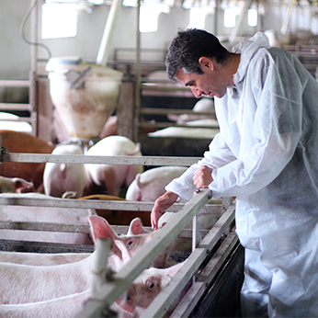
Veterinarians & Food Safety
Food Animal Production:
Disease prevention, control & treatment
Development of new medicines
Humane food animal harvesting*
*USDA Food Safety & Inspection Service (FSIS)
Notes:
Veterinarians, depending on their focused area of practice, are involved in all aspects of the food animal production chain from:
-disease surveillance, prevention, control and treatment of food animals
-to research and development of new medicines and treatments
-to ensuring animal harvesting/slaughter practices are humane and protect food safety, which is done through the USDA Food Safety & Inspection Service
The Food Safety and Inspection Service (FSIS) is the public health agency in the U.S. Department of Agriculture (USDA)

Slide 3
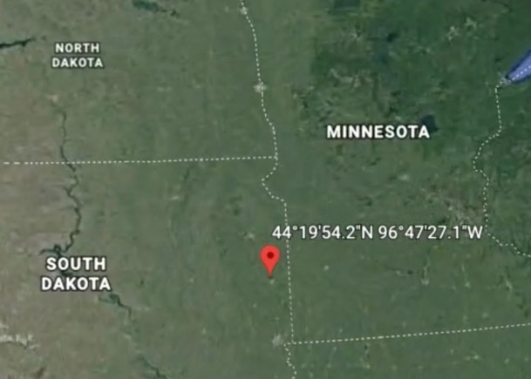

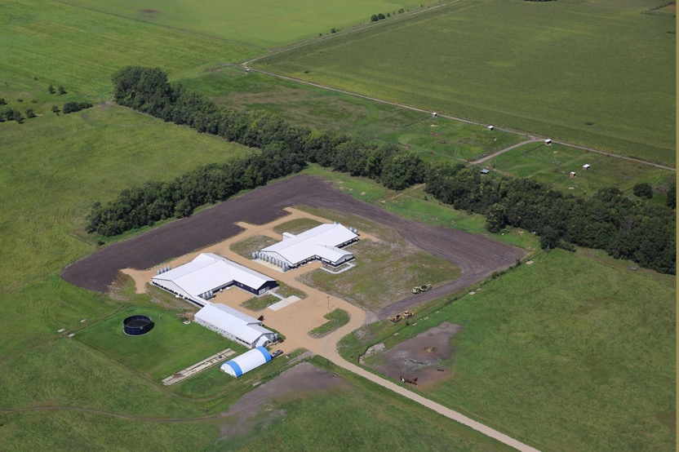
Live Pig Barn Tour
Brookings, South Dakota
Notes:
To see how advancements in food animal veterinary medicine and science-based farming practices are helping farmers raise healthy pigs we’re going to take you live right now inside a working pig barn at South Dakota State University in Brookings
Today, we have a South Dakota State University student joining us live to walk us through their working pig barn.
After the tour, I’ll help relay any questions you may have .
NOTE TO SPEAKER:
MINIMIZE PPT AND BRING UP ZOOM. WHEN TOUR IS COMPLETE MINIMIZE ZOOM AND BRING UP PPT.
FOLLOW DIAGLOGE PROVIDED SEPERATLY.

Slide 4
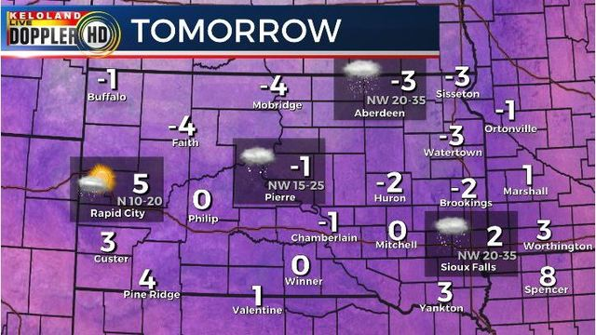
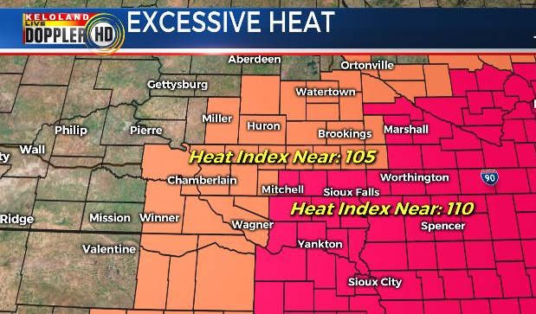
Specialized Barns & Pig Health
-2 Degrees
Brookings, South Dakota
February 2019
105 Degrees
Brookings, South Dakota
July 2019
Notes:
Our thanks to our tour guide and South Dakota State for the important inside look at how farmers are using the latest science and technology to raise healthy pigs.
Here’s a great example of why farmers use modern barns to protect pig health. These kinds of weather extremes are a fact of life in most parts of our country. Take a look – in February of this year Brookings saw temperatures of -2 degrees, not to mention the wind chills values that range anywhere from -15 to -40.
And then in July Brooking has heat advisories with heat indexes of nearly 105 degrees.
Think of the stress those kinds of extremes would cause any animal left outside.

Slide 5
Veterinarian’s Oath & Public Health
Being admitted to the profession of veterinary medicine, I solemnly swear to use my scientific knowledge and skills for the benefit of society through the protection of animal health and welfare, the prevention and relief of animal suffering, the conservation of animal resources, the promotion of public health, and the advancement of medical knowledge.
I will practice my profession conscientiously, with dignity, and in keeping with the principles of veterinary medical ethics.
I accept as a lifelong obligation the continual improvement of my professional knowledge and competence.
Notes:
Veterinarians play a crucial role in public health and food safety that often goes unnoticed.
The Veterinarian’s Oath calls on all veterinarians, no matter what their chosen area of practice, not only to protect animal health and welfare and but to also promote public health.

Slide 6

Veterinarians & Food Safety
Veterinarians protect America's – and the world's – food supply from the farm to the dinner table.
Notes:
The American Veterinary Medical Association also notes the following on its website about the responsibility veterinarians have to protect food safety.
“Veterinarians protect America's – and the world's – food supply from the farm to the dinner table.”
“As veterinarians, charged ethically with promoting public health and protecting animal health and welfare, we have great interest in the surveillance, prevention, control, and treatment of disease.”
Source: AVMA.org

Slide 7
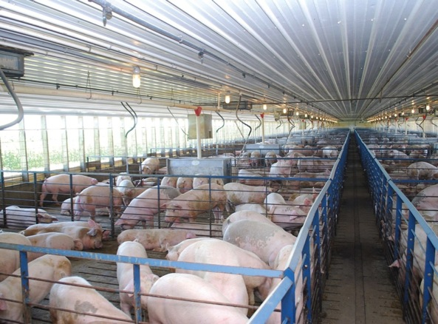
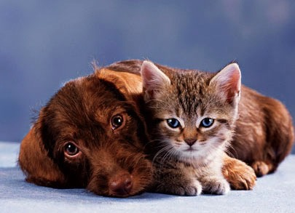
Veterinarians & Herd Health
Herd Health
Pet Health
Notes:
The biggest impact veterinarians have on food safety is working to ensure and improve animal health. Veterinarians take a different approach to doing that job depending on whether we’re treating companion animals or pets, versus animals raised for food.
In the “herd health” environment where food animal veterinarians work, not only do we care for individual animals, but we also work to help prevent disease and promote health and welfare throughout the entire herd of animals under our care.
This kind of population medicine has striking similarities with its counterpart for humans, which is public health. Both public health and herd medicine strive to keep their respective general populations healthy and know that there are increased risks for those within the populations with weaker immune systems – the young, old, pregnant, or immunosuppressed – for which they need to be prepared.

Slide 8
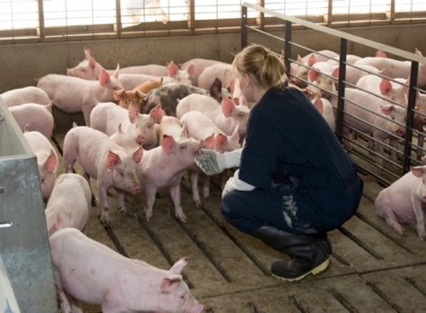
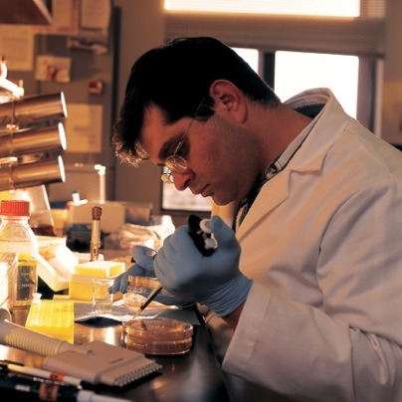
Herd Health Management
Minimizing Disease:
Barn design
Sanitation
Controlling traffic
Timely vaccinations
Identify/Treat/Control Disease:
Appropriate diagnostics
Antibiotics only when needed
Notes:
Swine veterinarians help farmers reduce the introduction of viruses and bacteria into their farms through herd health management strategies that include:
Barn design
Biosecurity/sanitation protocols like washing and disinfection of barns and anything else that may come in contact with pigs.
Controlling traffic of pigs, people, vehicles and other items that could carry diseases into a herd.
Timely vaccinations that enhance the herd’s immunity to diseases
Swine veterinarians also help farmers identify, treat and control and treat diseases through:
Appropriate diagnostics and tools, which can help veterinarians recommend the best prevention or treatment options for the bacterial and viral disease threats that can affect the herd.
Using antibiotics when needed to prevent treat and control bacterial diseases.

Slide 9
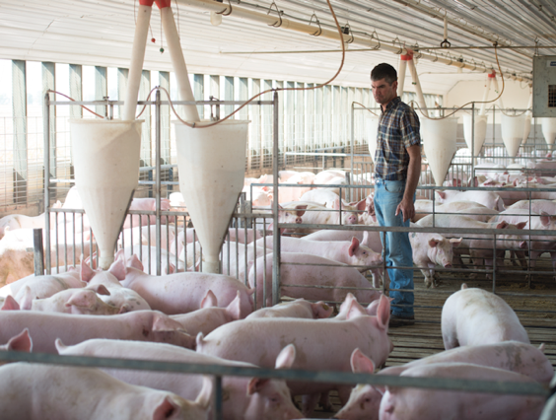
Herd Health Management
Veterinary medicine and science-based farming eliminated or significantly reduced:
Dysentery
Atrophic rhinitis
Actinobacillus
Brucellosis
Pseudorabies
Parasites
  University of Missouri Extension Commercial Agriculture Program
Notes:
Because of advances in veterinary medicine, science-based farming practices and new pig housing systems, the impact of many swine diseases have been eliminated or significantly reduced, including:
Dysentery
Atrophic rhinitis
Actinobacillus
Brucellosis
Pseudorabies
(Source: University of Missouri Extension Commercial Agriculture Program, November 2009)

Slide 10
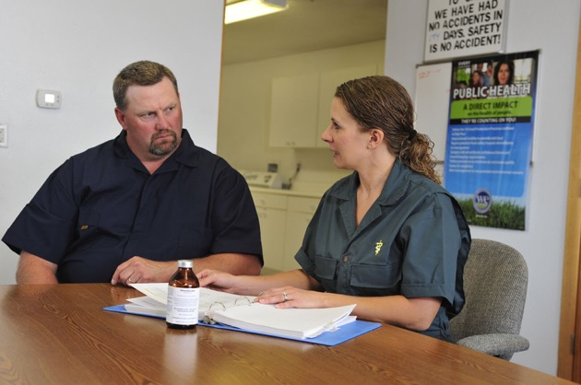
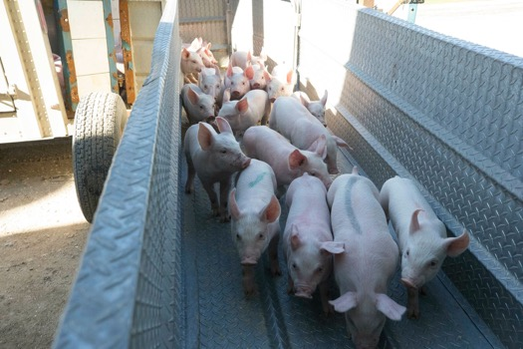
Veterinarians & Foreign Animal Disease
Also on frontlines to protect against Foreign Animal Diseases (FAD).
State veterinarians are first in command to:
Shutdown nationwide livestock movement for 72 hours.
Continue lockdown in states where FAD is suspected.
Open states after confirmed FAD not detected.
Notes:
Veterinarians are also on the front lines to protect against Foreign Animal Diseases (FAD)
When a FAD is identified the state veterinarian will be first in command to:
Shutdown all national livestock movements for 72 hours
Continue to lockdown movement in states where FAD identified
Open states for livestock movement in states where it’s confirmed FAD is not detected

Slide 11
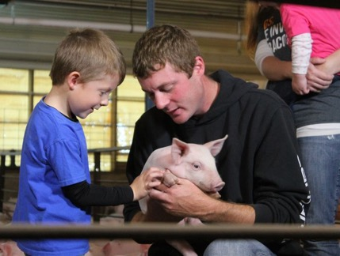
Keeping African Swine Fever (ASF) Out of U.S
A VIRAL DISEASE IMPACTING ONLY PIGS, NOT PEOPLE
U.S. Pork is Safe to Eat
ASF can’t be transmitted to humans through contact with pigs or pork.
ASF transmitted only to pigs by infected feed, equipment, clothing.
PIGS OR PORK ARE NOT ALLOWED IN U.S. FROM COUNTRIES WITH REPORTED ASF.
Notes:
Right now veterinarians along with a multitude of federal, state and local agencies are working to keep a highly contagious FAD out of the United States called African Swine Fever.
AFRICAN SWINE FEVER IS A VIRAL DISEASE IMPACTING ONLY PIGS, Not People.
U.S. Pork is Safe to Eat
ASF can’t be transmitted to humans through contact with pigs or pork.
ASF transmitted only to pigs by infected feed, equipment, clothing.
It’s also important to note that pigs or pork are not allowed in the U.S. from countries with reported ASF, which include at this time include China, other parts of Asia and some European countries.
The National Pork Board has been working closely with the National Pork Producers Council, the American Association of Swine Veterinarians and the Swine Health Information Center to monitor the situation and collaborate with the USDA.

Slide 12
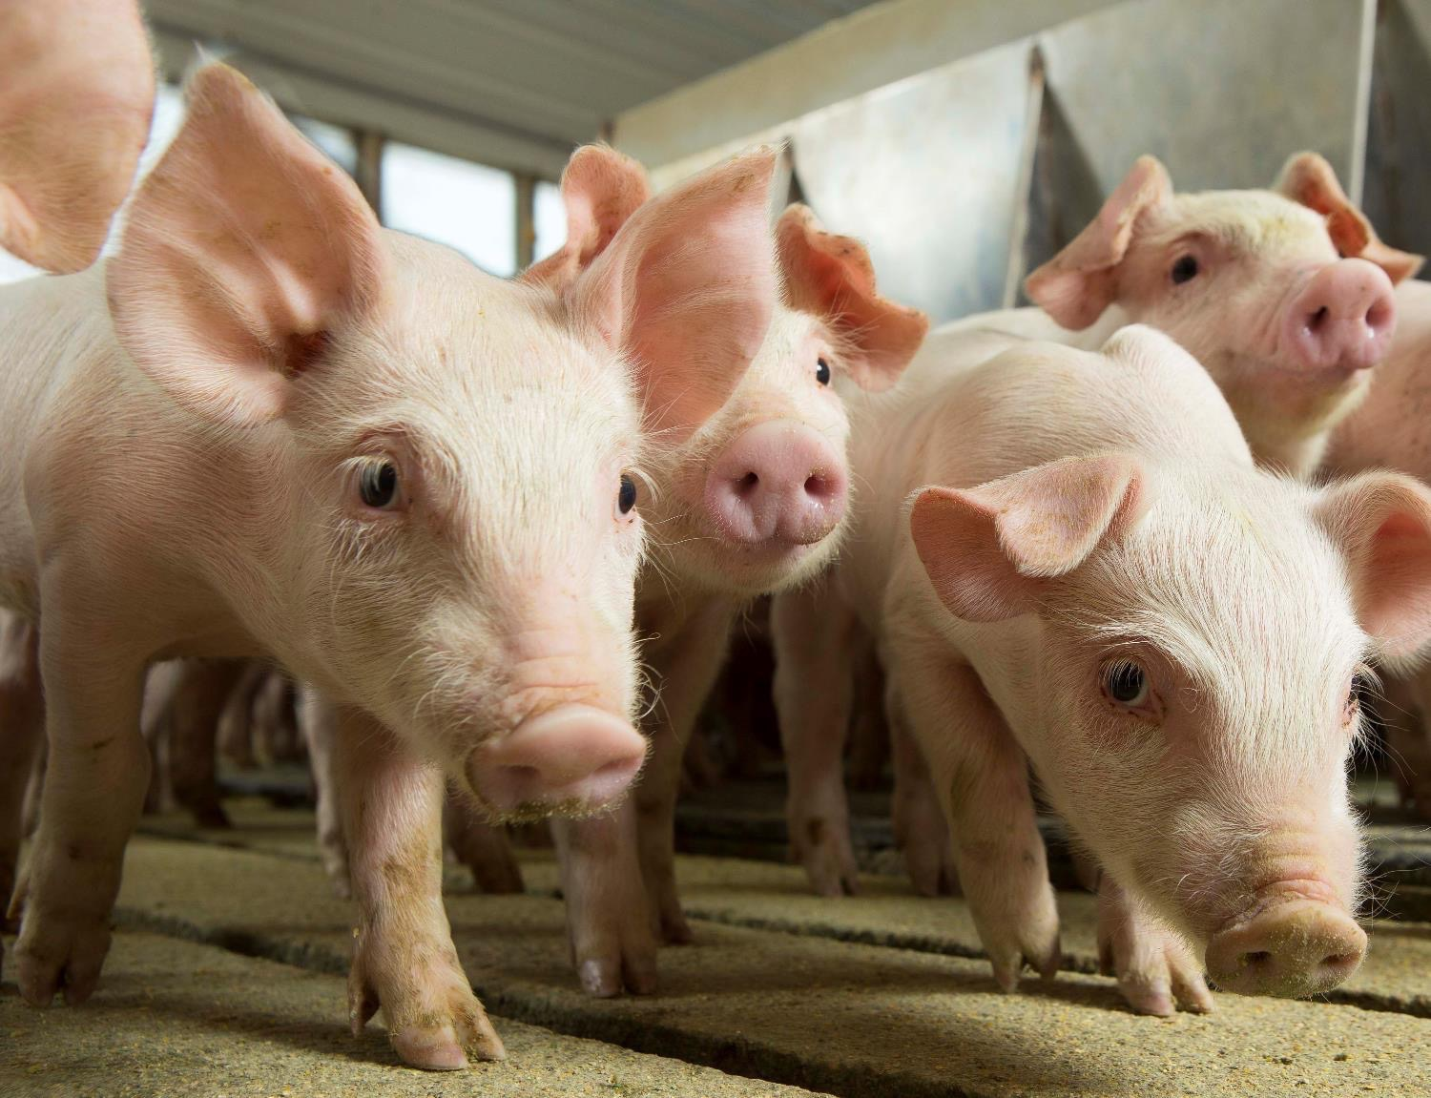
Healthy Pigs = Safe Food
Pig Farming & Continuous Improvement
Notes:
Now let’s talk about the pig farmer and swine veterinarian partnership and how it is a great example of how using science to continuously improve farming practices can benefit animal health and protect public health by providing safe, healthy food.

Slide 13
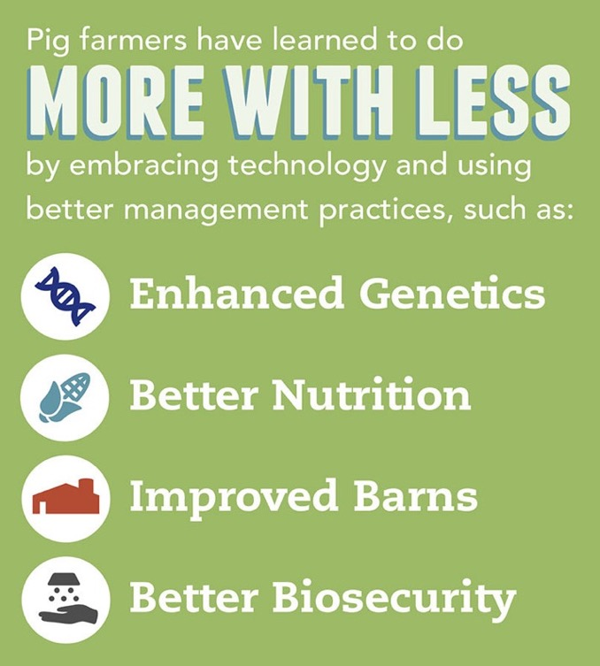
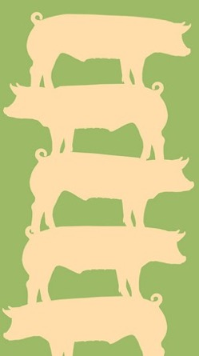
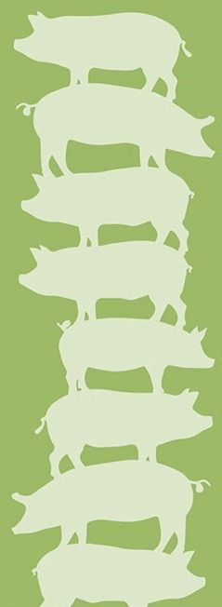
Pig Farming & Continuous Improvement
Today: 5 Pigs
1959: 8 Pigs
Fewer Pigs Today Provide Same Amount of Healthy Pork
(Per 1000 lbs. of pork produced.)
Notes:
Continuous improvement in pig farming means farmers can raise healthier more while using less land, water and energy. Today it takes fewer pigs to provide the same amount of safe, healthy pork than it did 60 hears ago. In 1959 it took 8 pigs to produce 1000 lbs. of pork. Today it only takes 5 pigs.
Farmers are doing better by using science-based health management practices that include:
Enhanced Genetics – which focus on consistently breeding animals with the optimum traits: female lines for productivity and males for growth and body type.
Better Nutrition – which involves carefully managing each pig’s diet during every stage of growth by providing the right nutrients and proteins at the right time.
Improved Barns– bringing pigs into modern barns to protect them from weather, parasites, and predators and to provide their pigs with a constant level of care.
Better Biosecurity that improves Animal Health – which includes disease prevention and control, vaccinations and medications – most of which are used under the supervision of a veterinarian.

Slide 14
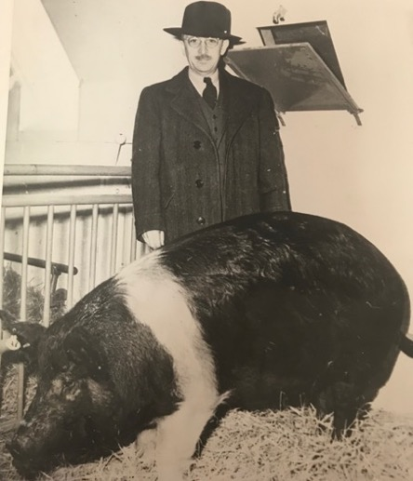
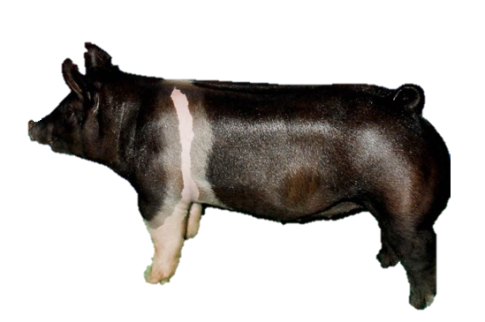
Pig Farming & Continuous Improvement
Pigs are 75% leaner than in the 1950s.
1950s Pig
Today’s Pig
Notes:
And today that means pigs are a lot healthier than they were 60 years ago.
In addition, pigs have 75 percent less fat compared with pigs from the 1950s.
Around World War II, pigs averaged almost (3) three inches of back fat compared with less than one (1) inch today.
So we’ve gone from producing lard to producing a lean and nutritious meat.

Slide 15
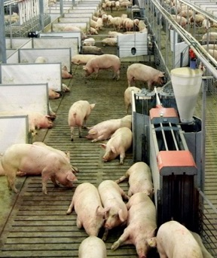
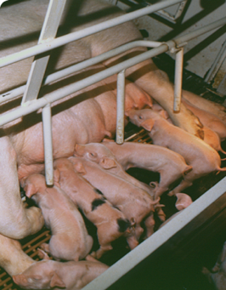
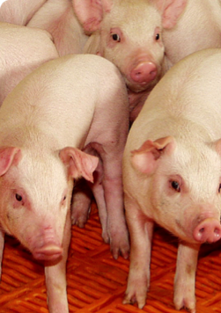
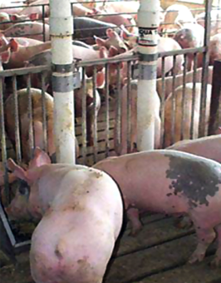
Pig Farming Phases
Specialized health care & nutrition during each phase.
Breeding/Gestation
Farrowing
Nursery
Growing/Finishing
Notes:
Raising pigs today is typically broken down into these four phases.
Breeding and then gestation when the sow goes through her pregnancy.
Farrowing is next when the sow gives birth to her pigs,
The nursery phase follows where the pigs receive vaccinations to help them get a healthy start.
The final phase is the growing/finishing phase before the pigs are sold or taken to market.
The pigs also receive specialized health care and nutrition to meet their needs during each phase of life.

Slide 16
Pig Farming Phases
Specialized health care & nutrition during each phase.
Breeding/Gestation
Farrowing
Nursery
Growing/Finishing
2-3 lbs.
15 lbs.
50 lbs.
270+ lbs.
Notes:
The whole growth cycle takes just six months.
Piglets weigh 2-3 pounds at birth and are weaned from the mother pig in 21-28 days.
At 21-days, they’ll weigh 15-20 pounds and usually are moved to a nursery barn where an optimum environment (heating and cooling) is maintained.
When pigs reach 40-60 pounds, they’ll go to a finishing barn where they are fed a nutritionally balanced diet to reach market weight at 270-285 pounds.

Slide 17
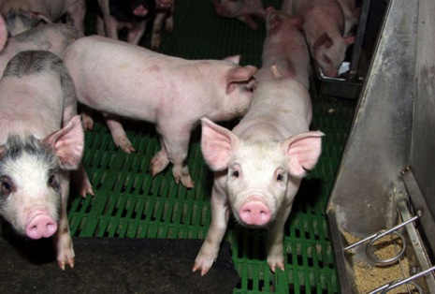
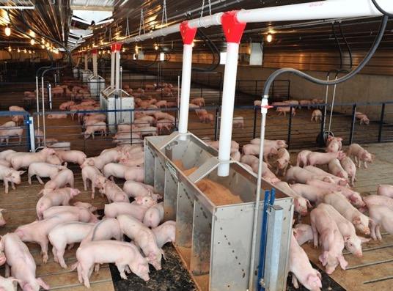
Nutrition & Pig Health
Nutrients for age, weight, gender:
  Amino acids
  Calories, carbs, fats
  Vitamins & minerals
8 - 10 feed formulations
Corn and soybeans
Goal: Efficiently convert feed into protein
Notes:
During the pig’s growth cycle, farmers carefully monitor feed formulations to address the nutritional needs of their pigs based on age, weight, and gender. The nutrient mix includes:
Amino acids
Calories, carbohydrates, fats
Vitamins and minerals
Overall, most pigs will get 8 to 10 different feed formulations during their lifetime, which are generally based on a blend of corn and soybeans.
The ultimate goal is to help pigs convert feed into protein as efficiently as possible.

Slide 18
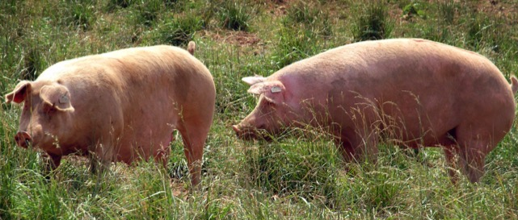
Pasture Raised & Grass-Fed
Pigs can be raised very successfully in pastures.
Pigs cannot efficiently digest grass and require grains to meet their nutritional needs.
Notes:
And a brief note about pasture-raised pork.
There’s occasionally confusion about the terms, “pasture raised and grass fed pigs.” They are not the same. Here’s why:
Pigs can be raised very successfully in pastures
Pigs cannot efficiently digest grass and require grains to meet their nutritional needs.

Slide 19
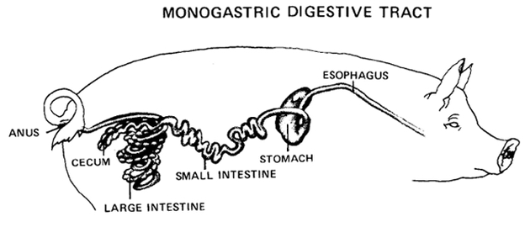
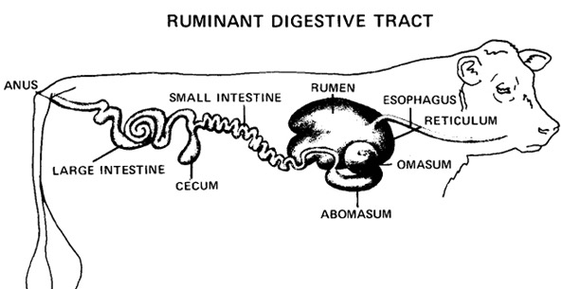
Nutrition & Pig Health
Pigs, like humans, are monogastric.
Need food that is easy to digest
1
Cows have 4 stomach compartments
Can better process fiber through expanded digestive track
2
1
3
4
Notes:
Why can’t pigs efficiently digest pasture grasses?
Because just like you and me, pigs are monogastric – they only have one stomach and need foods that can be easily digested in the stomach. Grasses are coarse fibers and need time to breakdown in the body so they can be digested. Young pigs in particular don’t even have the stomach capacity to eat enough grass to get what they need to grow.
Cows on the other hand have a digestive system that allows them to survive on pasture grasses as their primary source of feed. Cows are ruminant animals, which means they have four stomachs and can break down highly fibrous pasture grasses as they pass through each stomach with its contribution to the digestive process.

Slide 20
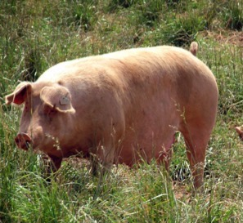
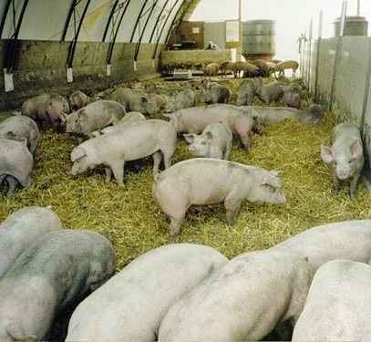
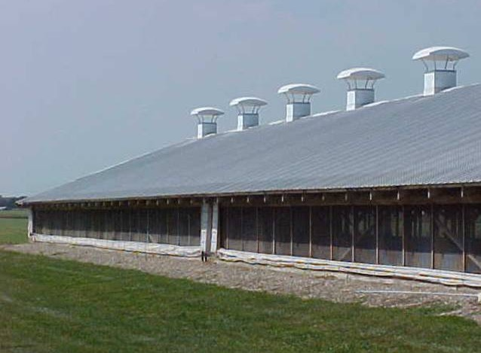
Today’s Housing Options
Pasture
Hoop
Specialized Barns
Notes:
Farmers have a lot of ways to raise to pigs today and all of these options can produce healthy pigs and safe food.
The primary options include:
Outdoors or pasture raised
Hoop Barns, which are tent-like structures that have concrete sidewalls.
Specialized Barns that are enclosed structures.

Slide 21
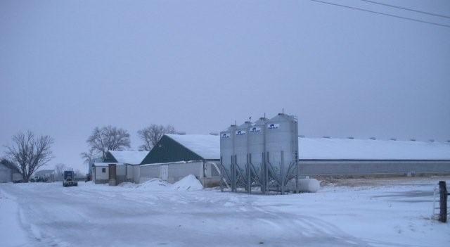
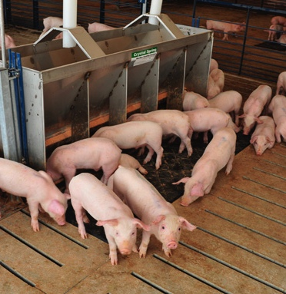
Specialized Barns & Pig Health
Protection: Weather, predators, disease
Constant levels of care and nutrition
Feed & water monitored to meet pig’s growth cycle
Notes:
But as I noted earlier, newer pig housing systems and specialized barns have contributed significantly to overall improved animal health.
Many farmers have chosen to move their pigs into specialized barns during the last 40 years.
These barns allow farmers to protect their pigs from weather, predators and disease. Pigs also receive a more constant level of care and nutrition.
For example, feed and water can be carefully monitored to meet each pig’s growth and development.

Slide 22
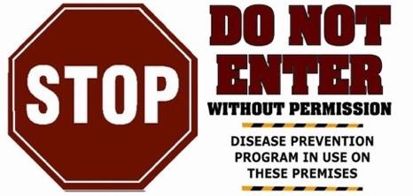
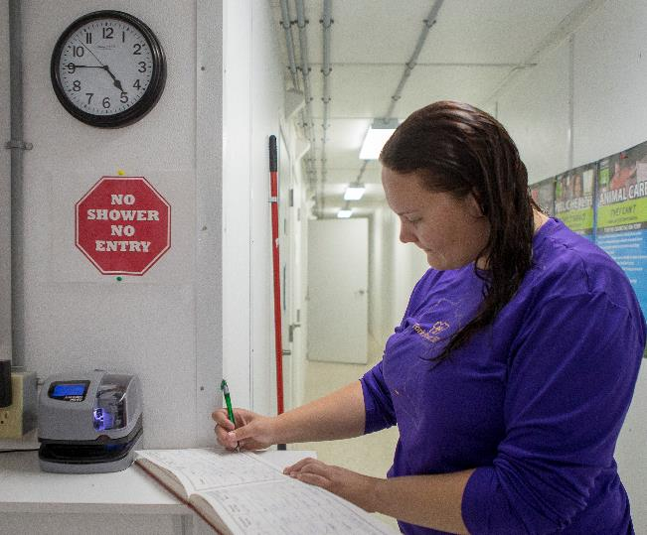
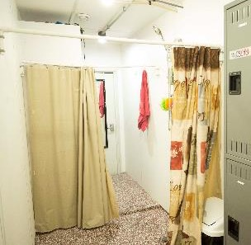

Disease Prevention & Pig Health
Notes:
A key component of raising healthy pigs in today’s modern barns involves Biosecurity Management.
Swine veterinarians often help farmers incorporate science-based biosecurity measures to prevent introduction & transmission of disease and disease-causing
agents into a herd.
These kinds of “stop” signs are posted to control access to barns. And some farmers ask people who work with their pigs to shower and put on clean coveralls and boots. Additional disease prevention measures include disinfecting any tools that are brought into the barns from outside.

Slide 23
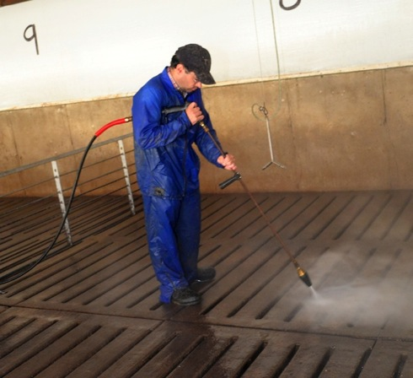
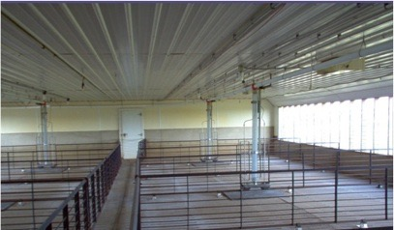
Disease Prevention & Pig Health
All-in/All-out Management Systems:
Animals moved in distinct groups
Reduces spread of disease
Facilities disinfected between groups
Notes:
Another modern biosecurity herd management practice is “all-in/all-out management systems” in which pigs are moved into and out of barns in distinct groups. By preventing the commingling of pig groups, farmers reduce the spread of disease.
All facilities are cleaned and disinfected thoroughly between groups of pigs.

Slide 24
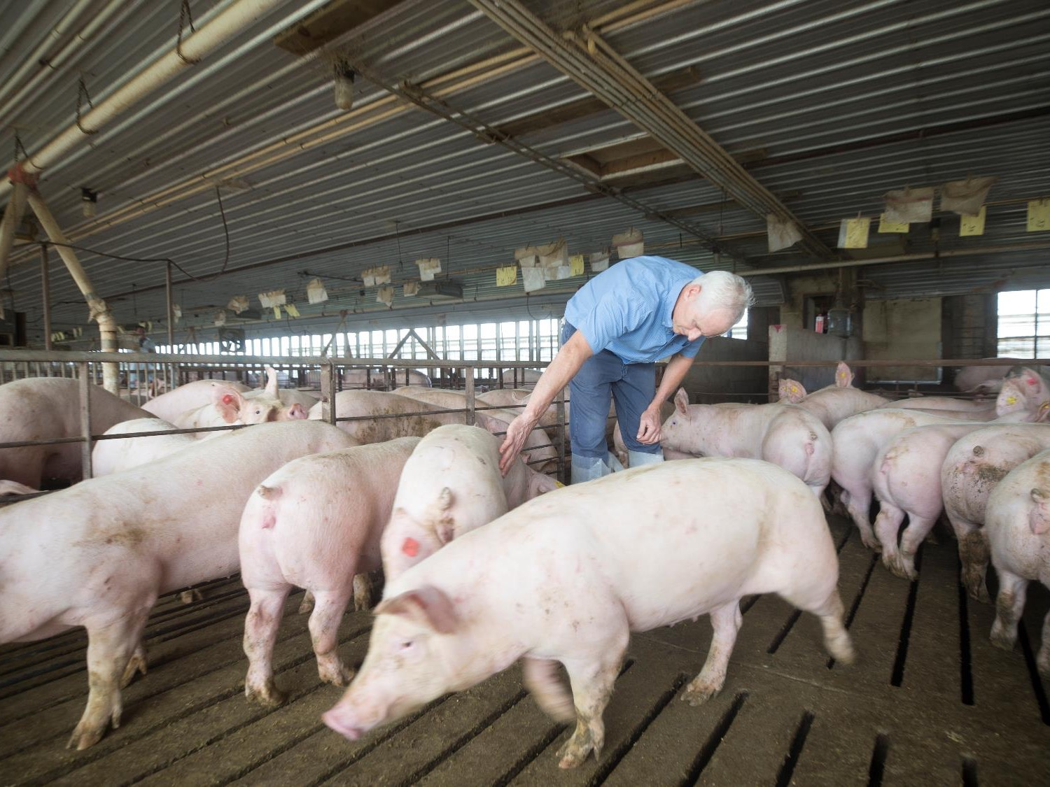
Responsible Antibiotic Use
Notes:
Raising healthy pigs means swine veterinarians may also use antibiotics to treat or control bacterial disease from spreading within a pig herd. We are committed to the responsible use of antibiotics to protect them for human and animal health.

Slide 25
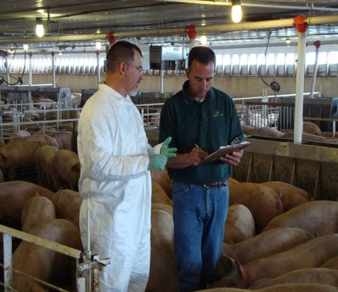
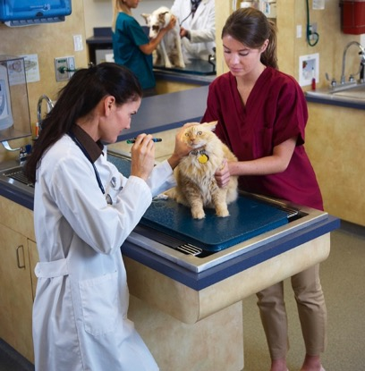
Responsible Antibiotic Use: All Species
Ensure antibiotic is:
Needed for condition
Appropriate for condition
Given in correct:
  Dose
  Frequency
  Duration
  Delivery method
  AVMA.org
Notes:
Protecting the effectiveness of antibiotics requires judicious use regardless of species – animal or human.
Veterinarians know they need to make sure using an antibiotic is:
Needed for that animal’s medical condition
The most appropriate choice for that condition
Given to the animal in the correct:
Dose
Frequency
Duration
Delivery method
Source: AVMA.org

Slide 26
FDA Antibiotic Classes
Medically Important
Important for treating human disease
Include: penicillins, cephalosporins, quinolones, fluroquinolones, tetracyclines, macrolides, sulfas, glycopeptides
Requires VFD for feed. Rx for water
Notes:
The FDA classifies medically important antibiotics as those that are important for treating human disease; these now require a VFD for use in animal feed and a prescription for use in water.
Included are:
Penicillins,
Cephalosporins,
Quinolones,
Fluroquinolones,
Tetracyclines,
Macrolides,
Sulfas,
Glycopeptides.
Before 2017 expansion of FDA rules, Pulmotil and nuflor already required a VFD.

Slide 27
FDA Antibiotic Classes
Medically Important
Important for treating human disease
Include: penicillins, cephalosporins, quinolones, fluroquinolones, tetracyclines, macrolides, sulfas, glycopeptides
Requires VFD for feed. Rx for water
Not Medically Important
Used almost exclusively in animal medicines & feed
Include: ionophores, polypeptides, carbadox, bambermycin, pleuromutlin
Available for nutritional efficiency
Available OTC for use in feed & water
Notes:
The FDA defines not medically important antibiotics as those used almost exclusively in animal medicines and feed.
They include:
ionophores
polypeptides
carbadox
Bambermycin
Pleuromutlin.
These antibiotics remain available for nutrition efficiency and/or over-the-counter (OTC) for use in feed and water – they do not require a VFD.

Slide 28
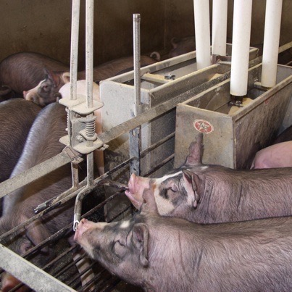
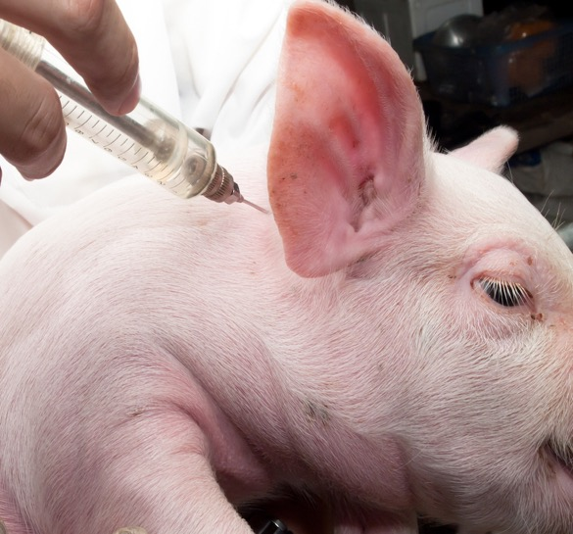
Responsible Antibiotic Use & Pig Health
Individual Pigs
Injection
Oral (piglets)
Herd/Group
Water
Feed
Notes:
Antibiotics are injected or provided orally for individual pigs.
For herd or group conditions, they are used:
In water to treat sick pigs
in feed and water for controlling the spread of disease or when pigs are most susceptible to illness.

Slide 29
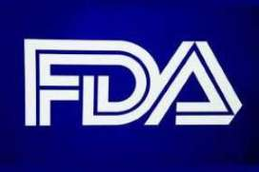
Responsible Antibiotic Use: All Food Animals
Updated rules for medically important antibiotics:
Veterinarian’s written authorization:
  Disease treatment
  Prevention
  Control
No growth-promotion/feed efficiency
Notes:
The FDA updated rules to take effect in 2017 on how farmers can use antibiotics on the farm in all food animals.
The changes applied to antibiotics used in food animals that are also important to human health and included:
Increased veterinary oversight. Farmers will need written authorization from a veterinarian to get medically important antibiotics for disease treatment, prevention and control.
No use of these antibiotics for nutritional efficiency/growth promotion in animal feed.

Slide 30
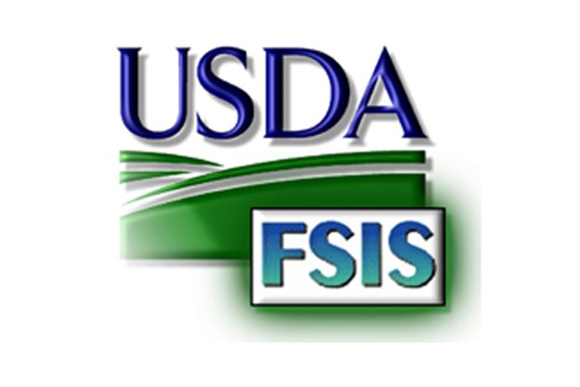
Antibiotic Safeguards
Food Safety & Inspection Service (FSIS) tests meat to ensure:
It is safe.
No harmful antibiotic residues enter the food supply.
Notes:
At the same time, the USDA’s Food Safety and Inspection Service (FSIS) tests meat to ensure it is safe and there are no harmful antibiotic residues entering the food supply.
FSIS tests and enforces antibiotic residue rules determined by the FDA.

Slide 31

Responsible Use Programs
Educates pig farmers about good on-farm production practices including responsible antibiotic use
73,000 pig farmers have been certified
18,678 farms undergone assessments
Notes:
The National Pork Board’s Pork Quality Assurance Plus program or PQA Plus already educates pig farmers about good on-farm production practices, and has increased it focus on responsible antibiotic use and training farmers on how to comply with evolving FDA rules.
More than 73,000 pig farmers have been certified through the program 18,600 farms have undergone assessments.
(NPB Figures are through February 2019)

Slide 32
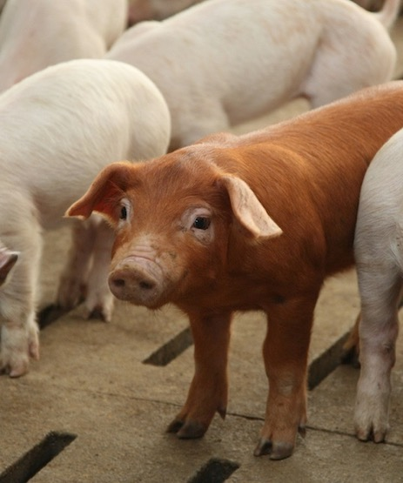
Antibiotic-Free Pork
“If a pig is sick, or at risk of getting sick, it should receive judicious antibiotic treatment.”
American Association of Swine Veterinarians
Notes:
And a brief word about antibiotic-free pork.
We all recognize there is a market for pork that is raised without antibiotics.
But the American Association of Swine Veterinarians has expressed concerns that “if a pig is sick, or is at risk of getting sick, it should receive judicious antibiotic treatment in order to avoid animal suffering.” This approach is also consistent with the Veterinarian’s Oath to prevent and relieve animal suffering.
Producers who raise antibiotic-free pork responsibly will provide treatment, but will not return the pig to their herd.
Source: https://www.aasv.org/news/story.php?id=8942 (The American Association of Swine Veterinarians’ (AASV) Board of Directors position statement - March 21, 2016)

Slide 33
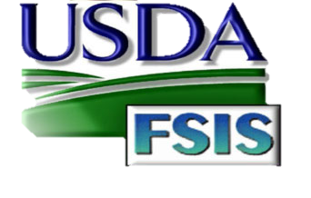
USDA Hormone Labeling Policy
Hormones are not allowed in raising market pigs. Therefore, the claim "no hormones added" cannot be used on labels unless it is followed by a statement that says,
"Federal regulations prohibit the use of hormones.”
Source: FSIS Fact Sheet Meat & Poultry Labeling Terms
Notes:
I also want to note the USDA has rules concerning hormone labeling.
Plain and simply, hormones are not allowed in raising market pigs. The USDA's Food Safety and Inspection Service is responsible for ensuring the truthfulness and accuracy in labeling of meat and poultry products. Its policy regarding labels promoting “no hormones” states the following:
Hormones are not allowed in raising hogs or poultry. Therefore, the claim "no hormones added" cannot be used on the labels of pork or poultry unless it is followed by a statement that says, "Federal regulations prohibit the use of hormones."
Source: www.fsis.usda.gov - Meat and Poultry Labeling Terms Fact Sheet

Slide 34
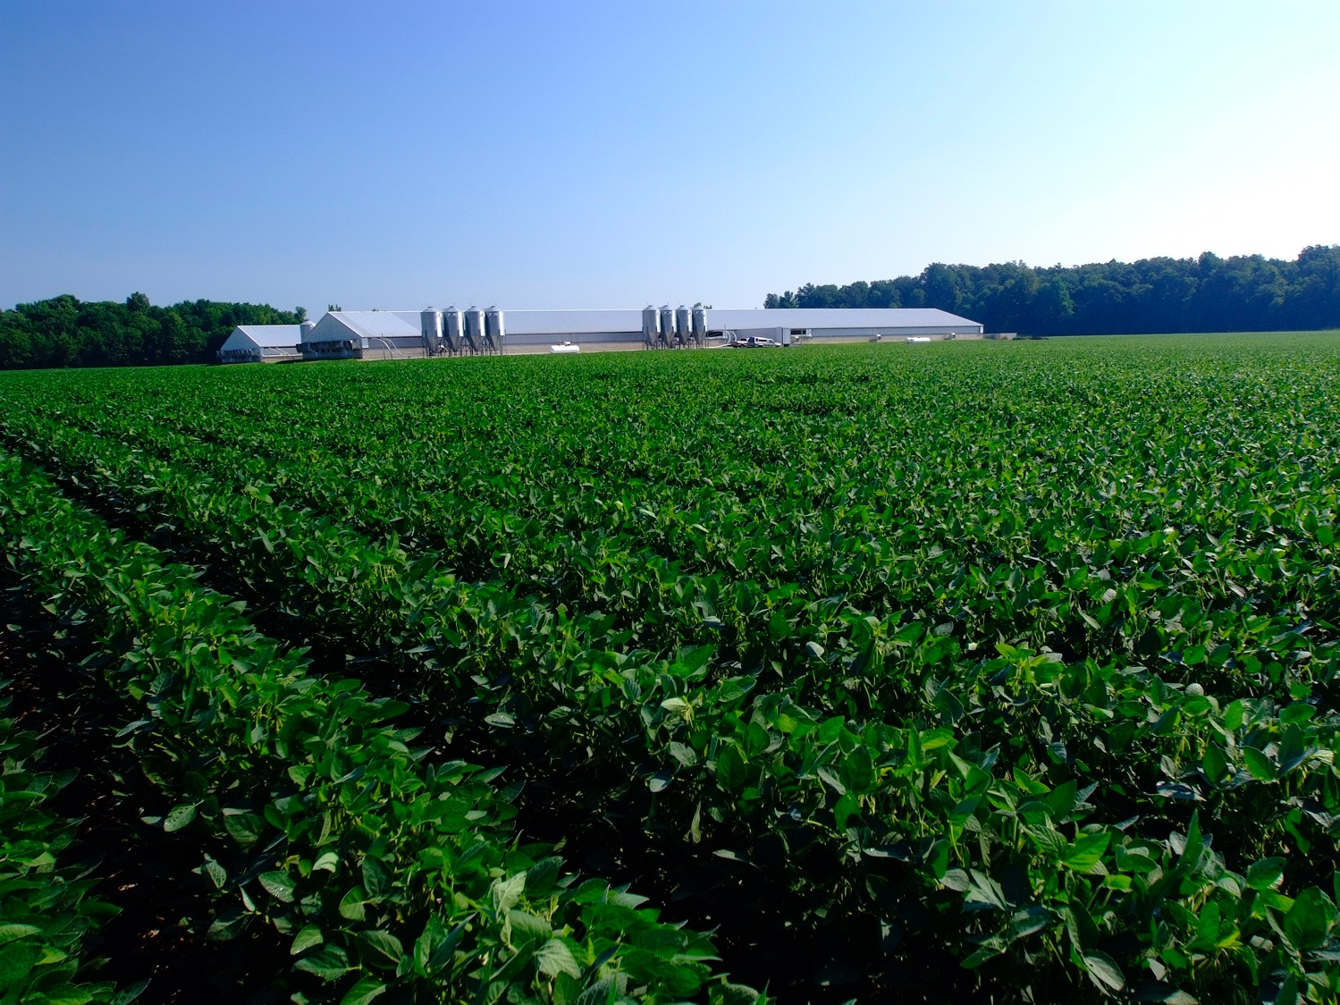
Responsible Pig Farming
Animal Welfare
Notes:
Beyond responsible antibiotic use, responsible pig farming also involves a commitment to providing pigs with the best care possible to protect their well-being.

Slide 35
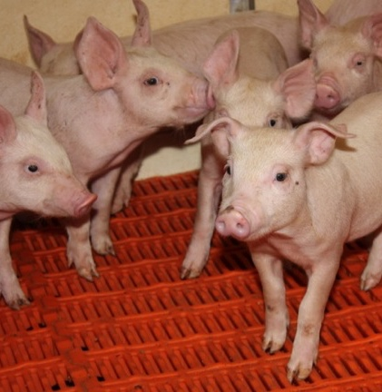
Pig Farming & Animal Welfare
Sow Housing
Pain Management
Euthanasia
Notes:
Veterinarians and science-based farming practices also play a key role in the discussion about animal welfare, and what’s best for the animal.
I’d like to cover a few key points concerning the following:
Sow Housing
Pain Management
Euthanasia

Slide 36


Sow Housing Systems
All housing systems should:
Minimize aggression & competition
Protect from weather extremes
Reduce injuries, pain, or disease
Provide access to food & water
Facilitate observation of individual sows
Promote sanitation
Allow normal patterns of behavior
Notes:
Let’s start with what the the AVMA and AASV (American Association of Swine Veterinarians) say about sow housing systems.
Regardless of the type of housing system in use, all housing systems should:
Minimize aggression and competition among sows
Protect sows from detrimental effects associated with environmental extremes, particularly temperature extremes
Reduce exposure to hazards that result in injuries, pain, or disease
Provide every animal with daily access to appropriate food and water
Facilitate observation of individual sow appetite, respiratory rate, urination and defecation, and reproductive status by caregivers
Promote good air quality and proper sanitation
Allow sows to express most normal patterns of behavior
The AVMA also adds that adequate quality and quantity of space should be provided.
Let’s see how these recommendations apply to the sow housing options farmers have available.

Slide 37


Sow Housing
Options for pregnant sow during gestation.
Each type of sow housing has benefits and limitations.
Individual stalls
Group Pens
Group pens
Notes:
The primary options farmers have available for pregnant sows are:
Group pens
Individual stalls
Each system has unique advantages and disadvantages for the sow.
A. The individual stalls are widely used by farmers to:
Ensure proper nutrition
Monitor individual health
Manage sow aggression
The challenges for sows in stalls include:
Restricted movement
Limited Social Interaction
B. In group pens, sows have the benefits of:
Social interaction
Room to move around the pen
At the same time, those benefits create challenges for the sow including:
Injuries from scratching and biting
Lameness from fighting
Competition for food and water

Slide 38

What’s the Best Sow Housing?
“Each can provide for sows’ welfare when properly managed, and caretaker skills are the most important factor.”
Dr. Tom Burkgren, AASV
Notes:
There is broad consensus in the veterinary community that the key to ensuring animal welfare for pigs rests primarily with the caretaker regardless of the housing used.
The executive director of the American Association of Swine Veterinarians or AASV noted in the Journal of the American Veterinary Medical Association (JAVMA) that:
“Gestation stalls and pens each have advantages and disadvantages. Each can provide for sows’ welfare when properly managed, and caretakers skills are the most important factor.”
(Source: Dr. Tom Burkgren, AASV, JAVMA News: Vol. 241,No. 3, August 1, 2012)

Slide 39
Pain Management
FDA approved for pigs
None
Notes:
Another area of discussion about animal welfare is pain management for pigs.
Unlike small animal veterinary care, swine veterinarians don’t have any FDA approved pain management products labeled for use in pigs.

Slide 40
Pain Management
FDA approved for dogs
  Meloxicam
  Carprofen
  Deracoxib
  Firocoxib
  Methylprednisolone
  Medetomidine
  Xylazine
  Pentazocine
FDA approved for pigs
None
Notes:
However, take dogs for example, there are many FDA approved products available that are labeled for use in dogs as an anesthetic or analgesic.

Slide 41
Euthanasia
“At times, it is the humane thing to do.”
Notes:
Another key area of animal welfare concern is euthanasia.
When a pig becomes sick or injured, veterinarians and farmers are faced with several courses of action.
However, when treatment fails - euthanasia may be the appropriate, humane option.

Slide 42

Responsible Pig Farming
Environmental Sustainability
Notes:
I’d like to conclude today’s discussion with a few brief slides about how modern pig farming practices affect sustainability.

Slide 43


Sustainable Pig Farming
U.S. pork production increased 84% from 1960 to 2015
While environmental impact decreased through:
    Advancements in pig breeding
    Improved pig feed and watering systems
    Smart Barn technology
    Increased crop yields
Notes:
While U.S. pork production increased 84% from 1960 to 2015, a new study from the University of Arkansas has revealed that the inputs needed to produce a pound of pork in the U.S. have become more environmentally friendly over this period.
At same time pig farming’s environmental impact decreased through:
Increased crop yields
Improved pig feed and watering systems
Smart Barn technology

Slide 44




Sustainable Pig Farming
Environmental impact reduced per pound of pork: 1960 - 2015
University of Arkansas: A Retrospective Assessment of U.S. Pork Production: 1960 to 2015
Notes:
According to the new study from the University of Arkansas titled: A Retrospective Assessment of U.S. Pork Production: 1960 to 2015, the inputs needed to produce a pound of pork in the United States became more environmentally friendly over time
By implementing science-based practices and advancements in agriculture technology, pig famers have achieved the following milestones:
When compared pound per pound to the 1960s, famers today:
Use 76% less land
Use 25% less water
Have reduced our carbon footprint by almost 8%
And have reduced energy use by 7%
Now let’s put some of these figures in perspective.

Slide 45

Sustainable Pig Farming: 25% Less Water Use
Notes:
Pig farmers have reduced the amount of water used by 25%. To save that much water in one year, everyone in the U.S. would have shower 90 fewer times.

Slide 46

Sustainable Pig Farming: 7% Less Energy Use
Notes:
Pig farmers have reduced the amount of energy used by 7%. farmers today have reduced their carbon footprint by almost 8%. To save that much energy, we’d all have to stop using our refrigerators.

Slide 47

Notes:
And while the emission of any type of greenhouse gas is too much, we do know that pig farming is actually one of the smallest sources of emissions. The EPA estimates that the pork industry contributes approximately one third of one percent of the total U.S. emissions.
The pork industry continues to work with scientists to develop new tools to help farmers further reduce their environmental footprint in the areas of land and water use, as well as carbon emissions.
Source: Inventory of U.S. Greenhouse Gas Emissions and Sinks 1990 - 2016 - Published April 12, 2018 by U.S. EPA

Slide 48



Pork’s Sustainability Framework
We CARE about:
Producing safe food
Protecting animal well-being
Protecting public health
Safeguarding natural resources
Providing a safe place to work
Contributing to a our communities
Notes:
Before we close, I want to share with you that the pork industry has established it’s own guiding principles for sustainable pig farming called WE CARE to promote responsible and ethical farming practices, and continuous improvement.
Through this program, pork producers pledge to put the highest ethical standards into practice every day by:
Producing safe and wholesome food
Protecting and promoting the well-being of our pigs
Ensuring our practices protect public health
Safeguarding natural resources in all of our practices
Providing all of our people a safe workplace
Contributing to a better quality of life in our communities

Slide 49

Swine Veterinarian Careers
Private Practitioner
Staff Veterinarian
Pharmaceutical Veterinarian
Genetics Veterinarian
Nutrition Consultant
Research & Teaching
Federal Government (USDA, APHIS, FSIS)
Epidemiologist
Notes:
Before I take questions, I do want to note that swine veterinarians have a wide variety of career options from private practice to research and teaching, and public health working in government agencies like the USDA.
I’d happy to discuss these options in more detail at the end of today’s presentation.

Slide 50

Student Memberships
Students pursuing DVM
$15 per year
AASV Student Member Benefits:
  Journal of Swine Health & Production
  AASV e-Letter
  Swine Information Library and Swine Disease Manual
  Scholarships & Externship Grants
www.aasv.org/students/
Notes:
If you want to consider becoming a student member of the American Association of Swine Veterinarians.
Any student enrolled in veterinary school pursuing a DVM (or equivalent) degree is eligible for student membership in the AASV for only $15.00 a year.
You receive a lot of great benefits that include:
A subscription to the Journal of Swine Health & Production
AASV e-Letter weekly email newsletter
Access to Swine Information Library containing more than 12,000 swine research papers
Online access to the Swine Disease Manual (4th edition)
Opportunities for Scholarships & Externship Grants
Check out many more benefits and join at www.aasv.org/students/

Slide 51
Notes:
Support for this presentation was provided by the National Pork Board and the Pork Checkoff.
Thank you and I’ll be happy to answer questions.

